Slide 1


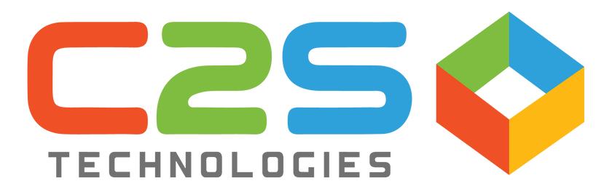
AI-Driven Multi-Agent System Using Genie for Enhanced Debt Recovery and Call Efficiency
Databricks AI & Machine Learning

Slide 2




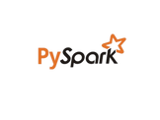
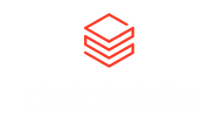


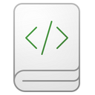
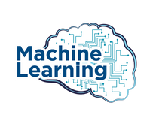
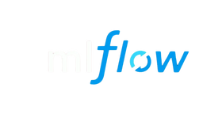

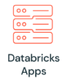

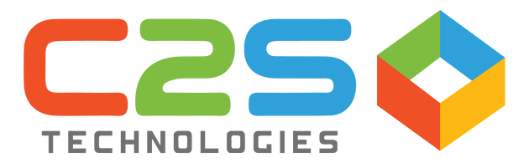
Architecture Diagram
_{Ingestion}
_{Processing}
_{Analytics}
_{Databricks Dashboard}
_{Azure ADLS Gen2}
Databricks Mosaic AI Multi Agent
_{Feature Engineering}
Features store intermediate Azure ADLSGen2
Databricks ML Flow for Model Creation and Training
ML Flow _{Model} Versioning
_{Model Inference Pipelines}
Model Output Data(Data bricks catalog/Azure ADLSGen2
Supervisor Agent
Recovery Prediction Genie Agent
User
Optimized call schedule Genie Agent
Databricks Chat APP/ AI Playground
AI Agent

Slide 3
Multi Agent & ML Model Workflow
Phase1: Prediction Recovery
Purpose: Predict repayment likelihood (60/90/120/180/360 days) using LightGBM
Phase2 : Vendor Call Optimization
Purpose: Optimize vendor communication by predicting call outcomes and recommending best contact times
Phase3: Multi agent combination
Combining both Prediction & Call optimization
Phase 4: Agentic(Mosaic) AI Solution
1. Feature Engineering Debt Recovery
2. Debt Recovery Model Training
3. Batch Inference Pipeline
4 .View Debt Recovery days table
3. Batch Inference Pipeline
1. Feature Engineering Call Optimisation
2. Optimized call log model Training & Registry
1. Model For both Debt And Call
1.Multiagent(LangGraph)system

